Slide 1
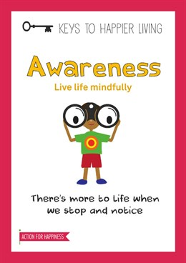
Awareness

Slide 2
Be Mindful
Recent research has shown that mindfulness meditation classes can lead to structural brain changes including increased grey-matter density in the hippocampus, known to be important for learning and memory, and in structures associated with self-awareness, compassion and introspection.
Try this simple 3 minute meditation:-
https://youtu.be/CVW_IE1nsKE

Slide 3
Ways to be Mindful
Mindful Colouring. ...
Connect with Nature. ...
Dragon Breathing. ...
Smell the Flowers Breathing Activity. ...
Practice Yoga. ...
Mindfulness 5-4-3-2-1. ...
Recite Positive Affirmations. ...
Practice Guided Meditations.

Slide 4
Be at one with Nature
1. Don’t be afraid of dirt!
2. Remember that the right clothing means there is no such thing as bad weather!
3. Let concentration grow through fascination.
4. Go for a bug hunt or track an animal.
5. Stay up to check out the night sky.
6. Take time to splash through the puddles and trail through the leaves.
7. Climb a tree!
8. Conquer your fears of creepy crawlies!
9. Roll down a hill, play conkers and pooh sticks….make perfume from flowers and pick blackberries!
10. Sign up to National trust’s ‘things to do before your 11’

Slide 5
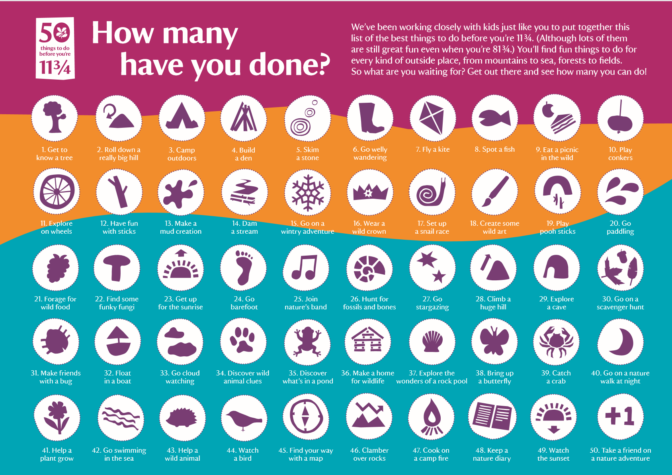

Slide 6
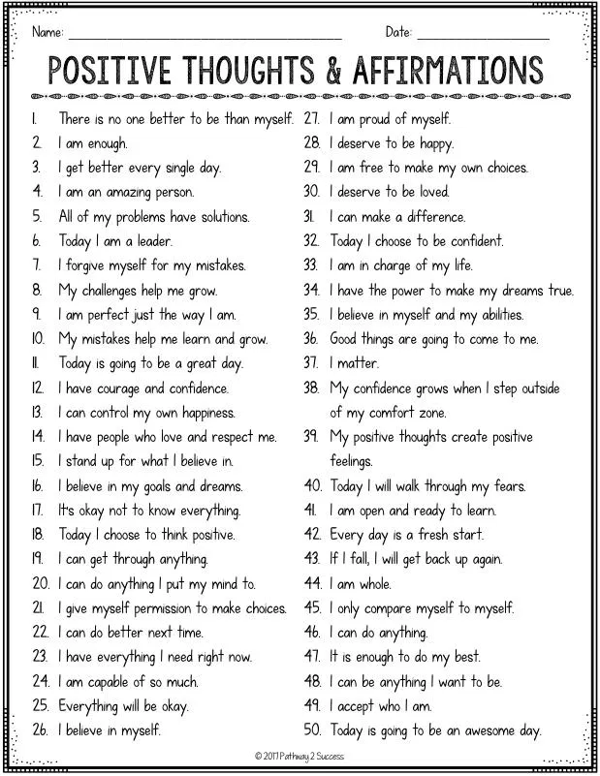

Slide 7


